Slide 1

EVEREST ENGINEERING COLLEGE
A
FINAL DEFENSE ON
“GATE”
Project Group Member
Avaya Poudel [19120045]
Bigyan Luitel [19120049]
Pawan Kharel [19120069]
Prabin Bhusal [19120072]
26th of September 2021

Slide 2
contents
1. Introduction
2. Problem statement
3. Objective
4. Applications
5. Project Features
6. Feasibility Study
7. Literature Review
8. Methodology
9. Output
10. References
Notes:
‹#›

Slide 3
INTRODUCTION
Common Platform.
GATE is good for relevant results.
Network/Bridge.
1
Notes:
‹#›

Slide 4
PROBLEM STATEMENT
Time consuming and tiring.
Difficult to find qualified tutors.
Not responsive.
Verification issues.
Security Problems.
Limited
2

Slide 5
OBJECTIVE
To find tutors for students easily and provide opportunity to the qualified tutors.
3

Slide 6
APPLICATIONS
Students/Parents can easily get a tutor.
Tutors can just sign in and get students (job).
Parents/Students can select tutors as per their requirement.
This system can improve the security and Tutoring Culture.
4

Slide 7
PROJECT FEATURES
Tutor can:
Sign Up/Login
Manage Profile
Manage Schedule
Student/Parent can:
Sign Up/Login
Manage Profile
Hire a tutor
Admin can:
View tutor/ Student
Manage Tutor/ Student Profile
See WebApp Data and Details
Respond to all kind of Requests by tutor and Students.
5

Slide 8
FEASIBILITY STUDY
Economic Feasibility
Technical Feasibility
Operational Feasibility
Time Feasibility
6

Slide 9
LITERATURE REVIEW
As per American Tutor Association (American Tutor Association), a tutor must have a typical requirement to be a tutor. But, we do not have any sort of tutor association i.e. we do not have any criteria to become a tutor.
As per the article (Alija & Florjancic, 2007), online tutoring is a solution to quality issues of learning.
MeroTutor: Tutor monitoring about their qualification is not properly examined. (Mero Tutor, 2016)
Home Tuition App: Not accessible to all type users. (NRS
Services Pvt. Ltd., 2018)
7

Slide 10
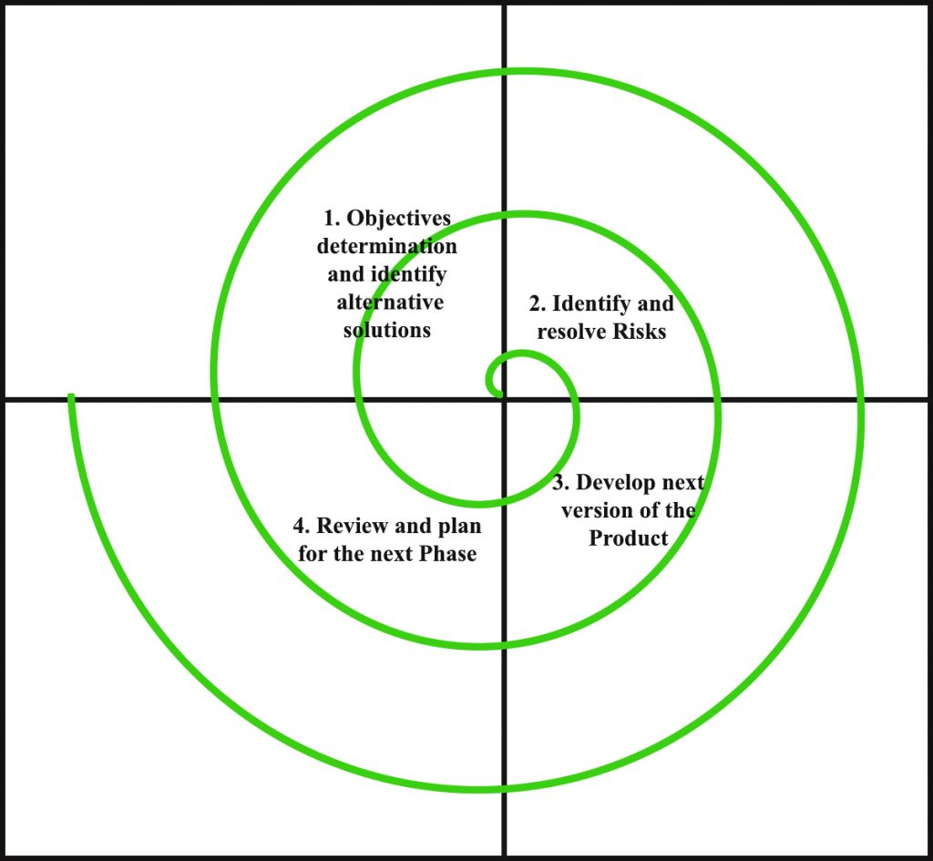
METHODOLOGY
8
Figure: Spiral Model

Slide 11
SYSTEM REQUIREMENT
Hardware Requirement
Software Requirement
9

Slide 12
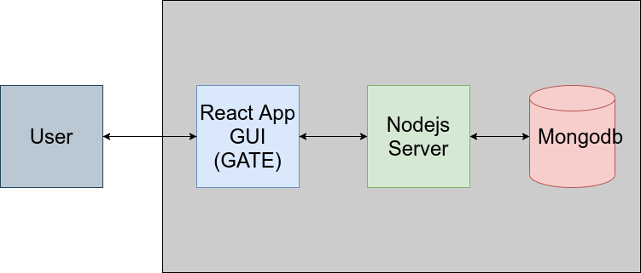
BLOCK DIAGRAM
Figure: Block diagram of GATE website
10

Slide 13
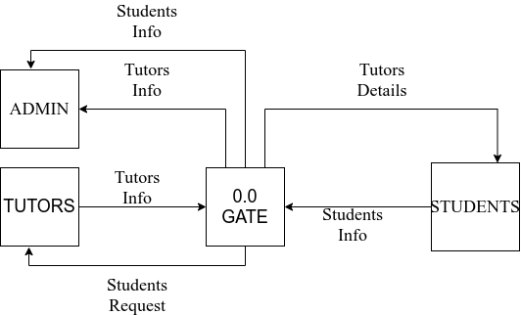
DATA FLOW DIAGRAM
11
Figure: Data Flow Diagram 0 level

Slide 14
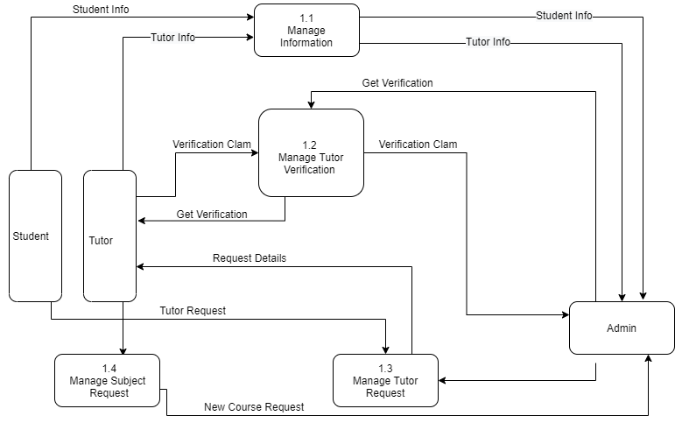
DATA FLOW DIAGRAM
12
Figure: Data Flow Diagram 1 level

Slide 15
BUDGET ANALYSIS
Table Budget Analysis
Hourly cost per programmer | Rs.50
No. of hours per day | 5 hours
No. of working days per week | 5 day
Project Period | 8 week
Extra cost | Rs.500
Total project cost | Rs.10,500
13

Slide 16
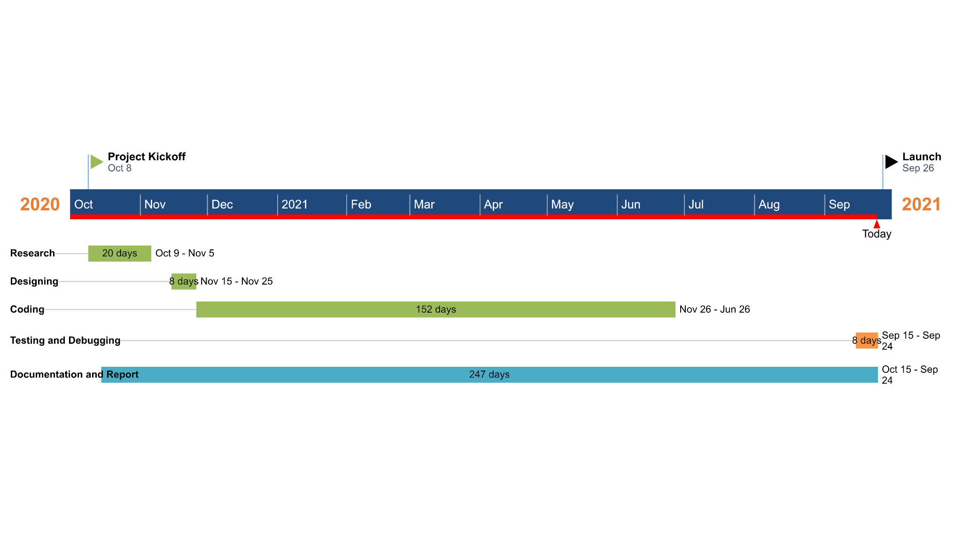
GANTT CHART
Figure: Gantt Chart
14

Slide 17
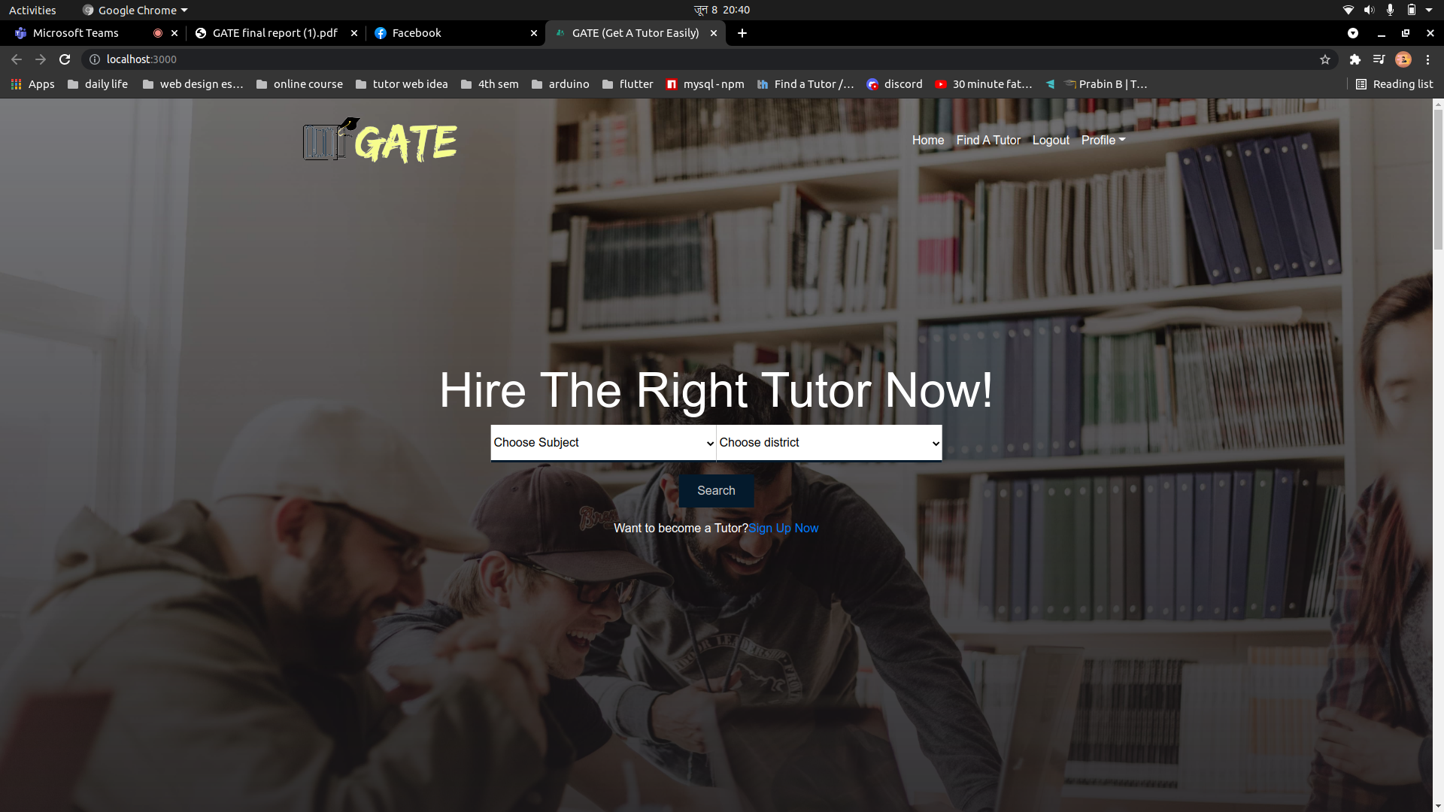
OUTPUT
15

Slide 18
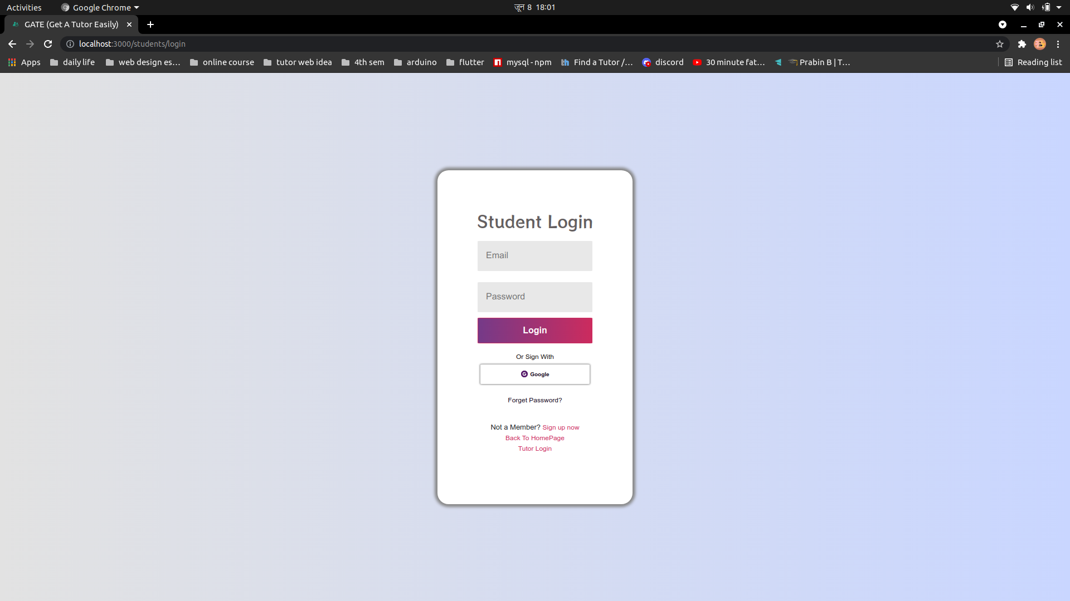
16

Slide 19
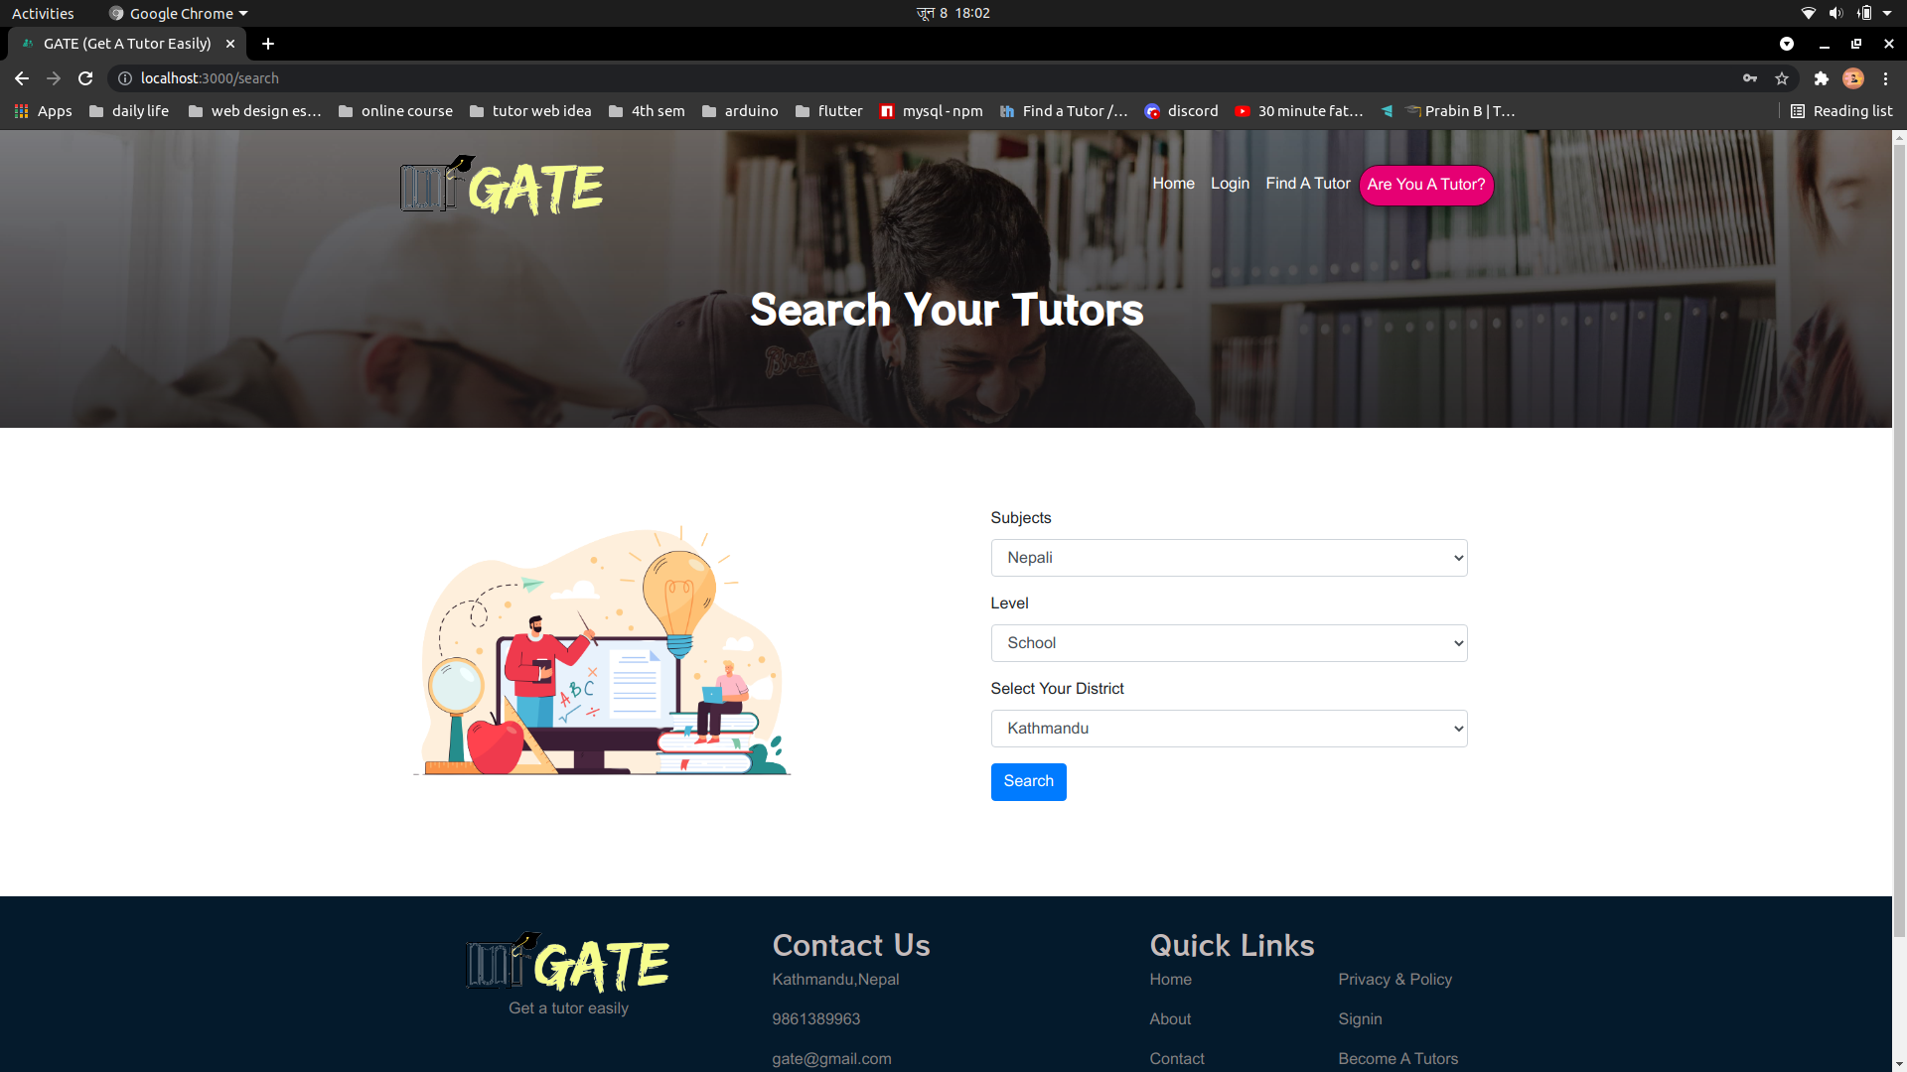
17

Slide 20
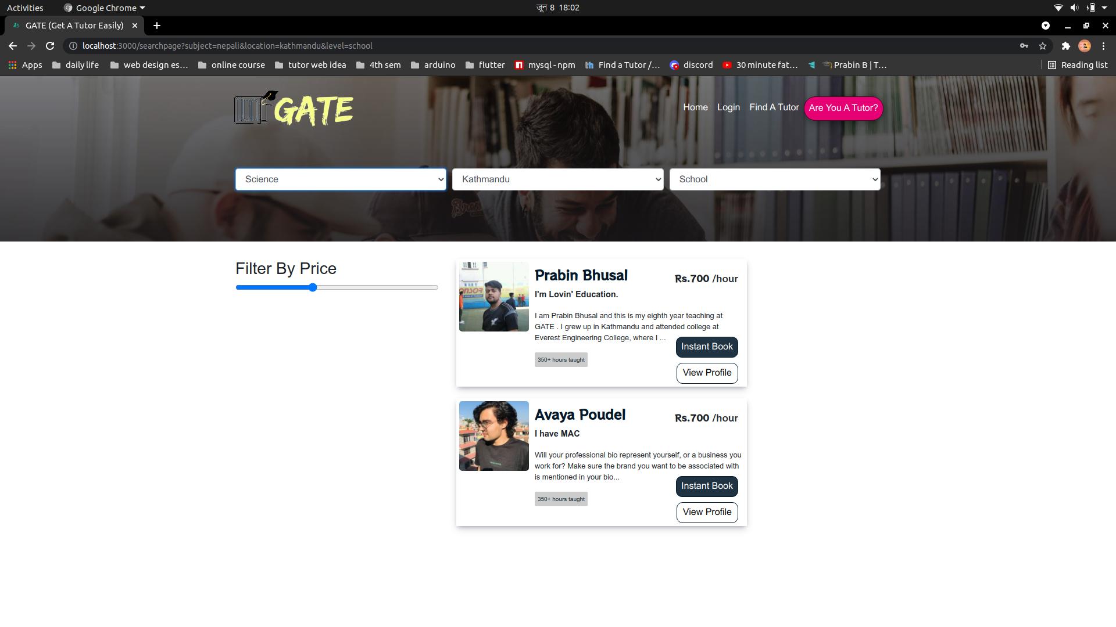
18

Slide 21
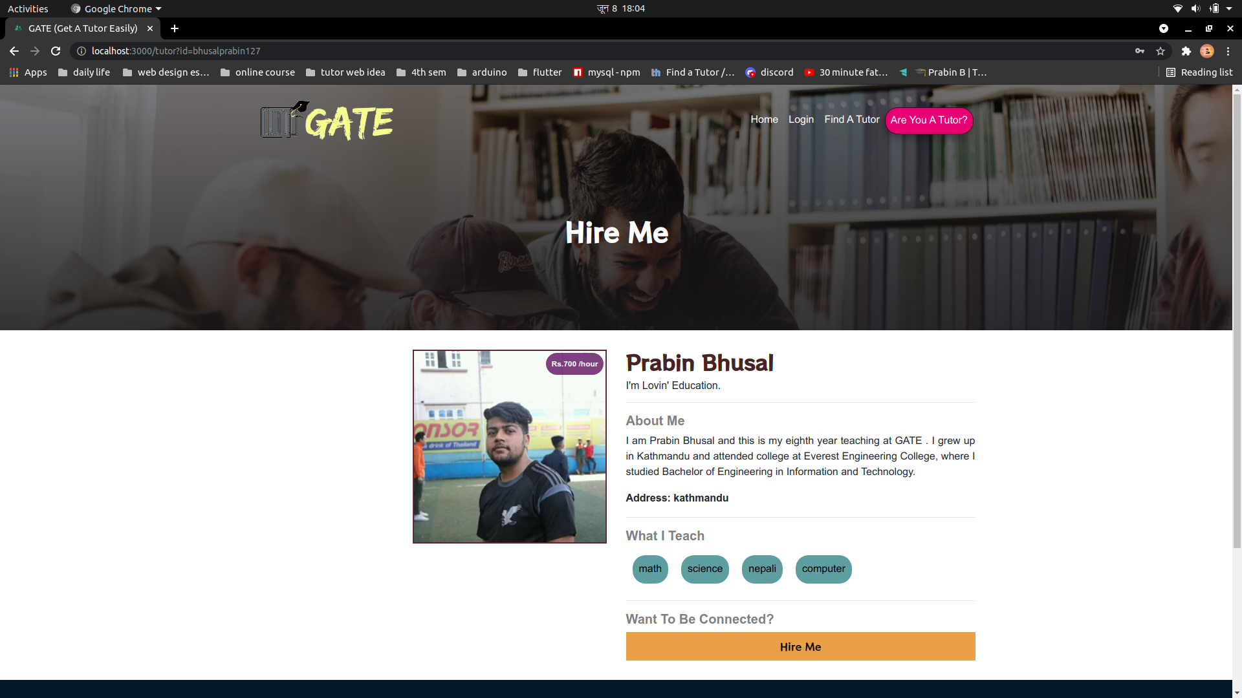
19

Slide 22
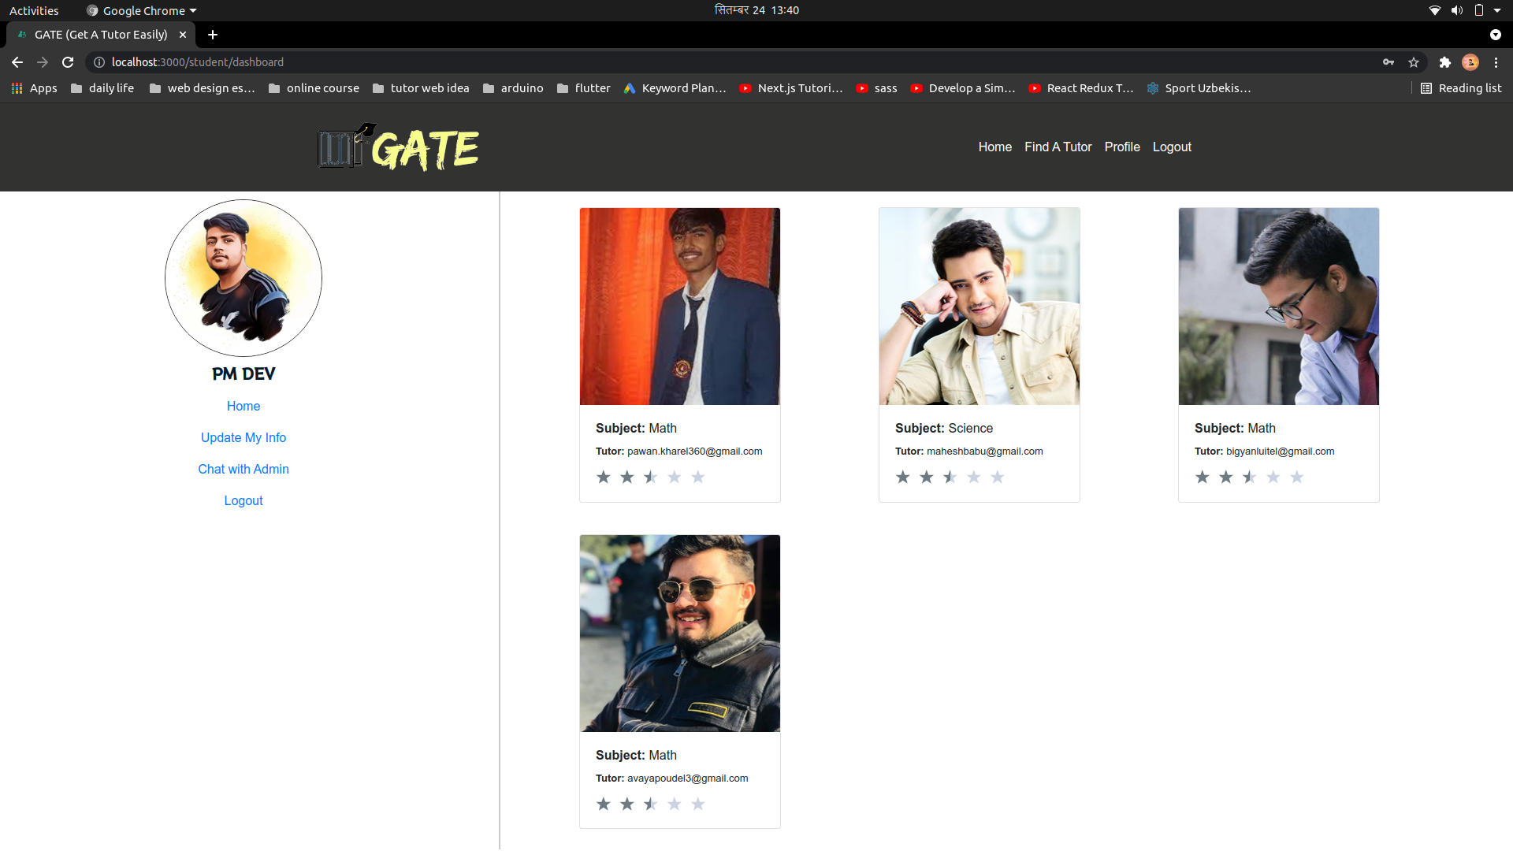

Slide 23
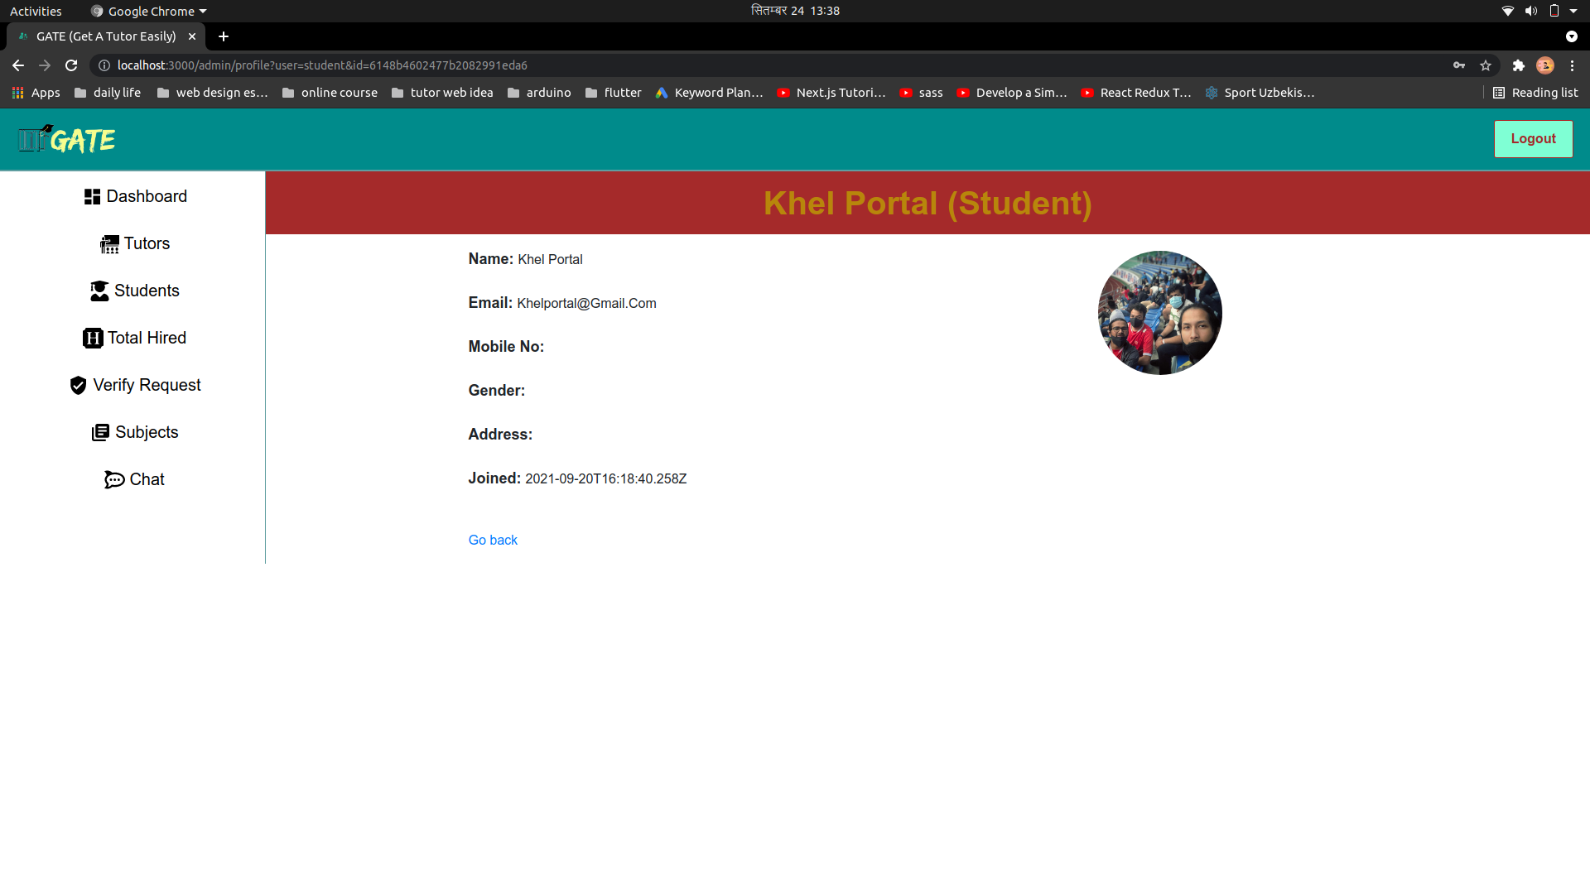

Slide 24
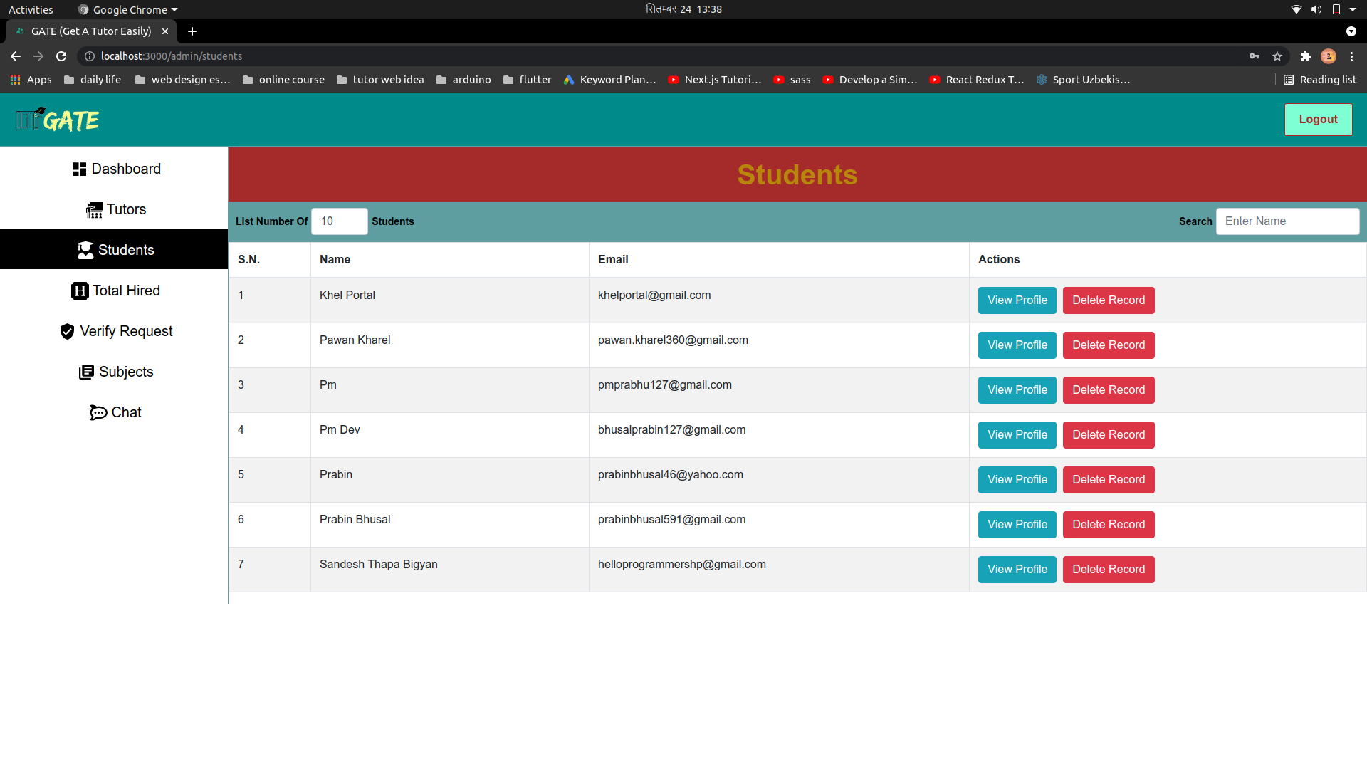

Slide 25
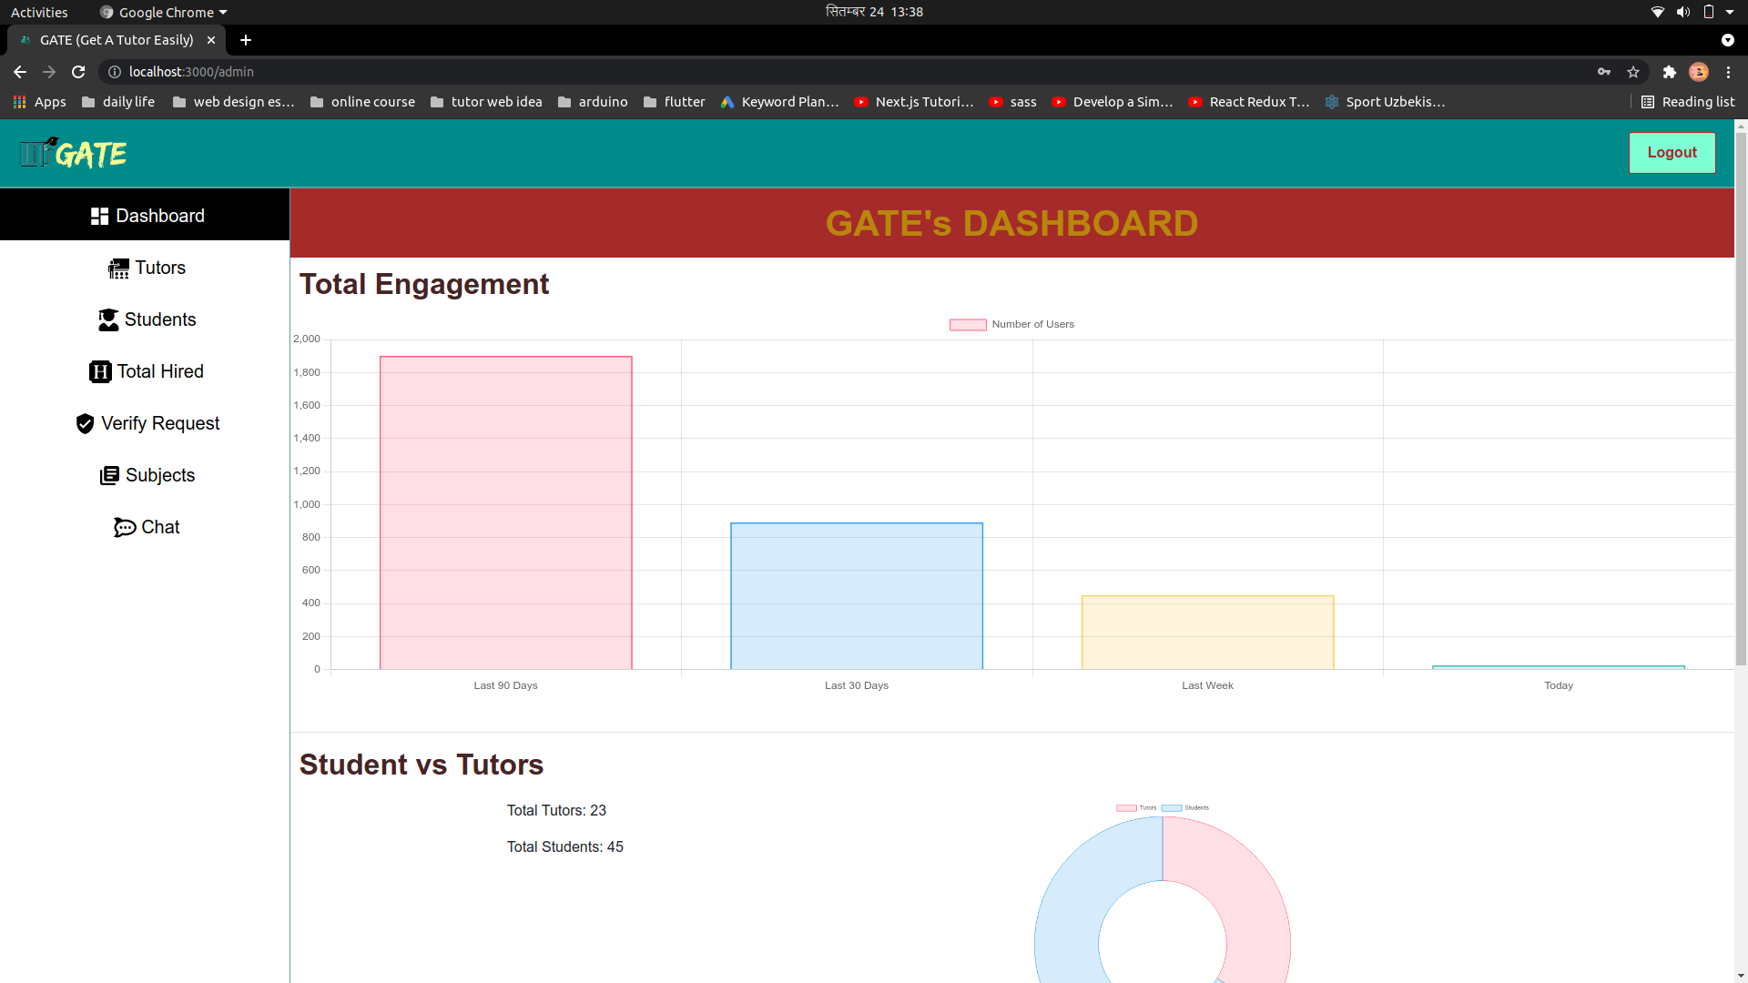

Slide 26
PROBLEM FACED
Lack of proper group discussing and physical interaction.
Problem in sending email.
Debugging problems.
Connecting front end with API’s.
24

Slide 27
REFERENCES
Alija, I., & Florjancic, V. (2007). Can Online Tutors Improve the Quality of E-
Learning ? Research Gate. Retrieved from
https://www.researchgate.net/publication/320656534_Can_Online_Tutors_Im
prove_the_Quality_of_E-learning
American Tutor Association. (2001). Retrieved from
http://www.americantutoringassociation.org/
Mero Tutor. (2016). Retrieved from Mero Tutor: www.merotutor.com
NRS Services Pvt. Ltd. (2018). Retrieved from Hamro Tuition Nepal:hamrotuitionnepal.com
25

Slide 28
Thank you...
Let’s Have a Demo!!

